Slide 1
Artificial Neural Network Diagrams for Study Group
05/26/20
Online-ds-pt-100719PT

Slide 2
EXAMPLE NEURAL NETWORK
Single Neuron
Neural Network
Binary classification
2 Hidden Layers

Slide 3

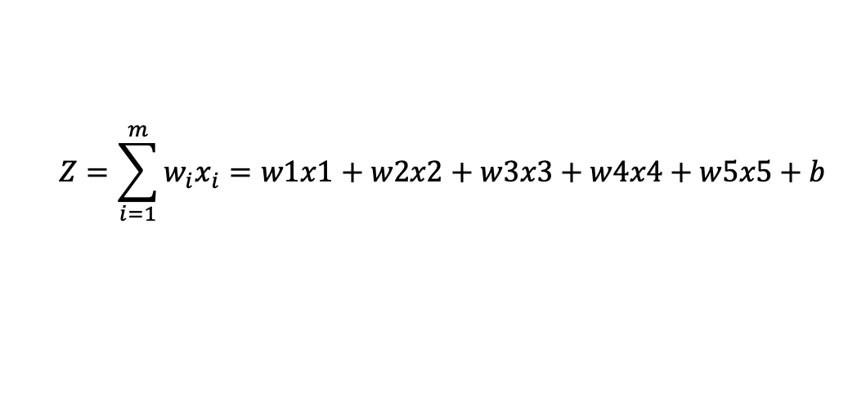
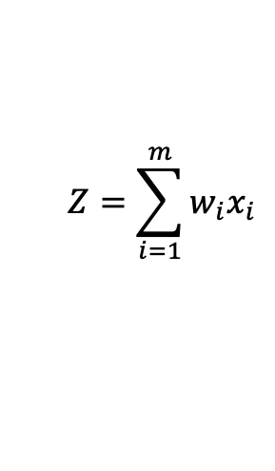

INPUT LAYER
$$Z=\sum_{i=1}^{m}{w_{i}x_{i}=w1x1+w2x2+w3x3+w4x4+w5x5+b}$$
X1
$$f\left(Z\right)$$
= Activation function
w1
X2
w2
$$Z=\sum_{i=1}^{m}{w_{i}x_{i}}$$
$$a=f(Z)$$
X3
w3
Output
w4
X4
w5
X5

Slide 4
INPUT LAYER
OUTPUT LAYER
X1
X2
X3
X4
X5

